Slide 1
40th Anniversary of Friendship
Seevetal, Germany and
Decatur, Illinois

Slide 2
In The Beginning- People to People

Slide 3
1967 Vote to be Taken

Slide 4
1967 Sister City Plan Approved!

Slide 5
1976

Slide 6
1974

Slide 7
1975

Slide 8
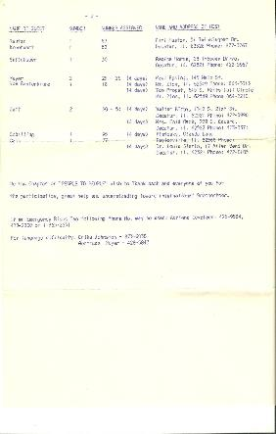
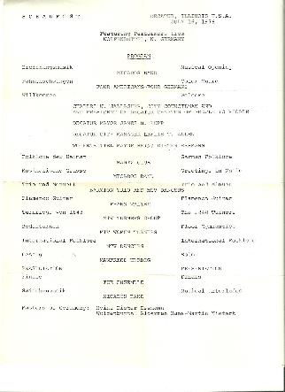
Attendees and Agenda in 1976

Slide 9
1976

Slide 10
1977

Slide 11
1978

Slide 12
1978

Slide 13
1978

Slide 14
1982 Youth from Sister Cities share Favorite Sports!

Slide 15
1982

Slide 16
1988

Slide 17
1988

Slide 18
1998

Slide 19
1998

Slide 20
1999

Slide 21
2002

Slide 22
2002

Slide 23
2002

Slide 24
2002

Slide 25
2002

Slide 26
2002

Slide 27
2002

Slide 28
2002

Slide 29
2002

Slide 30
2002

Slide 31
2002

Slide 32
2002

Slide 33
2002

Slide 34
2002

Slide 35
2002

Slide 36
2002

Slide 37
2003

Slide 38
2003

Slide 39
2004

Slide 40
2004

Slide 41
2004

Slide 42
2004

Slide 43
2004

Slide 44
2004

Slide 45
2004

Slide 46
2004

Slide 47
2004

Slide 48
2004

Slide 49
2004

Slide 50
2004

Slide 51
2004

Slide 52
2004

Slide 53
2004

Slide 54
2004

Slide 55
2004

Slide 56
2005

Slide 57
2005

Slide 58
2005

Slide 59
2005

Slide 60
2005

Slide 61
2005

Slide 62
2005

Slide 63
2005

Slide 64
2005

Slide 65
2005

Slide 66
2005

Slide 67
2005

Slide 68
2005

Slide 69
2005

Slide 70
2005

Slide 71
2005

Slide 72
2005

Slide 73
2005

Slide 74
2005

Slide 75
2005

Slide 76
2005

Slide 77
2005

Slide 78
2005

Slide 79
2005

Slide 80
2005

Slide 81
2005

Slide 82
2005

Slide 83
2005

Slide 84
2005

Slide 85
2005

Slide 86
2005

Slide 87
2005

Slide 88
2005

Slide 89
2005

Slide 90
2005

Slide 91
2005

Slide 92
2005

Slide 93
2005

Slide 94
2005

Slide 95
2005

Slide 96
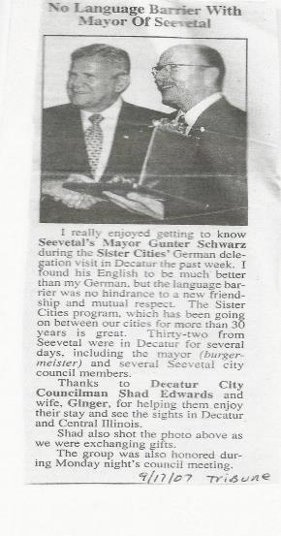
2007

Slide 97
2007

Slide 98
2007

Slide 99
2007

Slide 100
2007 Signed by Senator Bomke

Slide 101
2007

Slide 102
2007

Slide 103
2007

Slide 104
2010

Slide 105
2010

Slide 106
2010

Slide 107
2010

Slide 108
2010

Slide 109
2010

Slide 110
2010

Slide 111
2010

Slide 112
2010

Slide 113
2010

Slide 114
2010

Slide 115
2012

Slide 116
2014

Slide 117
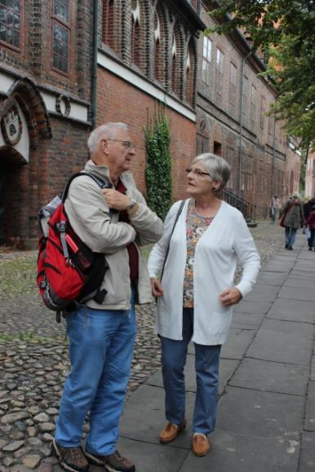
2014

Slide 118
2015

Slide 119
2014

Slide 120
2014

Slide 121
2014

Slide 122
2014

Slide 123
2014

Slide 124
2014

Slide 125
2014

Slide 126
2014

Slide 127
2014

Slide 128
2014

Slide 129
2014

Slide 130
2014

Slide 131
2014

Slide 132
2014

Slide 133
2014

Slide 134
2014

Slide 135
2014

Slide 136
2014

Slide 137
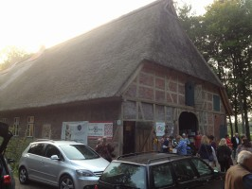
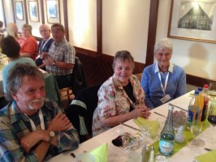
2014

Slide 138
2014

Slide 139
2014

Slide 140
2014

Slide 141
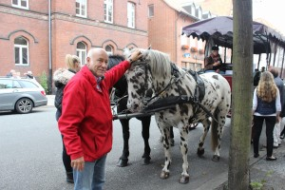
2014

Slide 142
2014

Slide 143
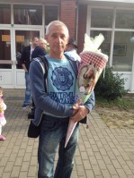
2014

Slide 144
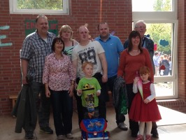
2014

Slide 145
2015 Kathy visits Dagmar

Slide 146
40 wonderful years

Slide 147
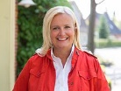
Mayors Martina Oertzen and Julie Moore Wolfe

